Slide 1

Java and Databases, The Basics
I'll show you how to connect to a database, using a connection string, and a special object, called a Java Database Driver.
We'll get information from the database, through a database language called Structured Query Language or SQL.
I'll demonstrate how to execute SQL statements as strings against tables in the database, using Java's support, and how to process the results we get back from these types of queries.
I'll also cover executing parameterized statements, using Java's PreparedStatement, which allow SQL statements to be reusable, more flexible, and less prone to some well known security issues.
COMPLETE JAVA MASTERCLASS
Introduction

Slide 2
Java and Databases, Additional Support
Many Database Management Systems support a built-in procedural language as well.
This means there may be functions stored with the database, that you can use to get data, or perform some action, rather than actually writing SQL code to do it.
I'll be showing you how to make calls to these database stored procedures, with Java's CallableStatement.
Finally, we'll examine different object relational mapping or ORM technologies, used by popular Java frameworks, to handle basic boiler plate interactions with databases.
COMPLETE JAVA MASTERCLASS
Introduction

Slide 3
Why I chose MySQL for this section of the course
It's free, and downloaded from Oracle, and the installation isn't too difficult.
I think it's important to learn about CallableStatements, and for that, we needed a database that support stored procedures.
I offer a beginner's course in SQL which also uses MySQL, if you want to learn more.
MySQL is a popular industry standard.
COMPLETE JAVA MASTERCLASS
Introduction

Slide 4
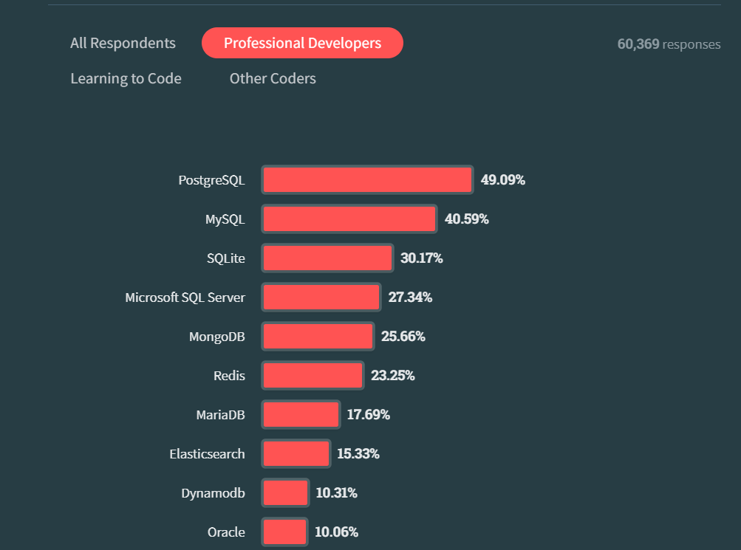
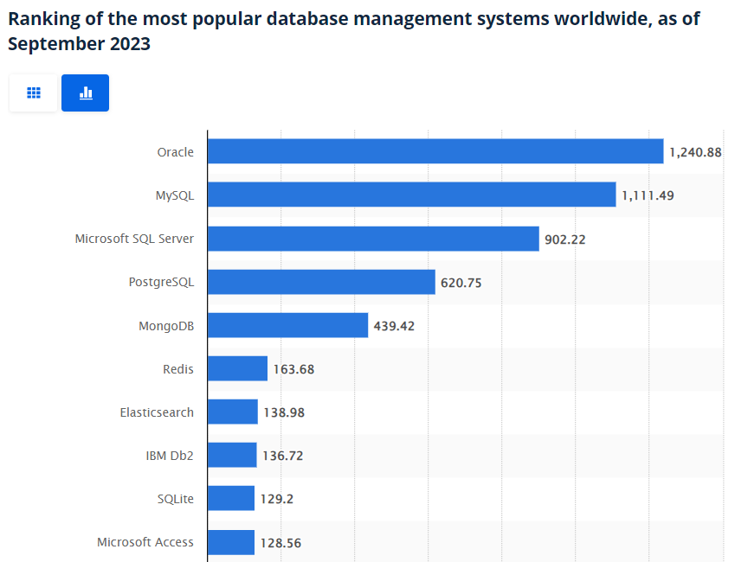
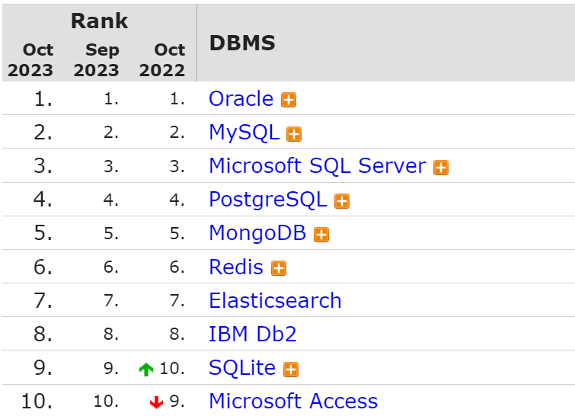
Database Popularity Surveys
2023 stackoverflow.com Survey of Developers https://survey.stackoverflow.co/2023/ | 2023 Survey of Corporations https://www.statista.com/statistics/809750/worldwide-popularity-ranking-database-management-systems/ | DB-Engines Ranking https://db-engines.com/en/ranking
COMPLETE JAVA MASTERCLASS
Introduction

